Slide 1


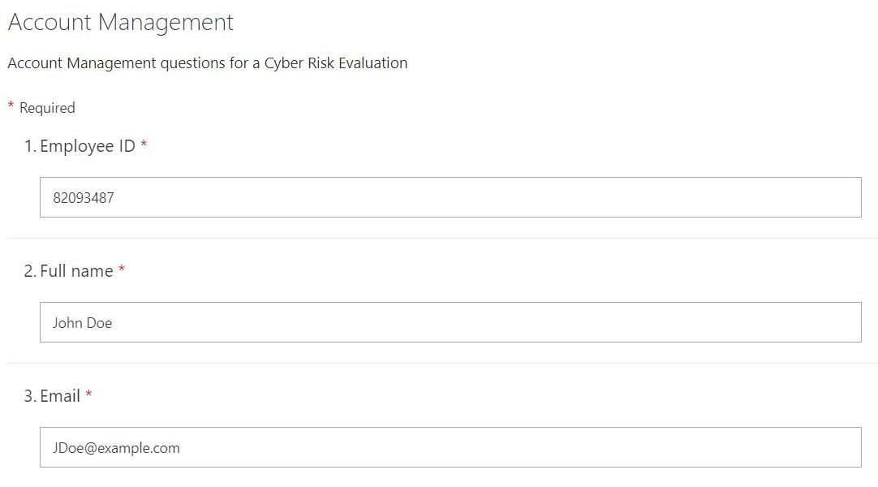

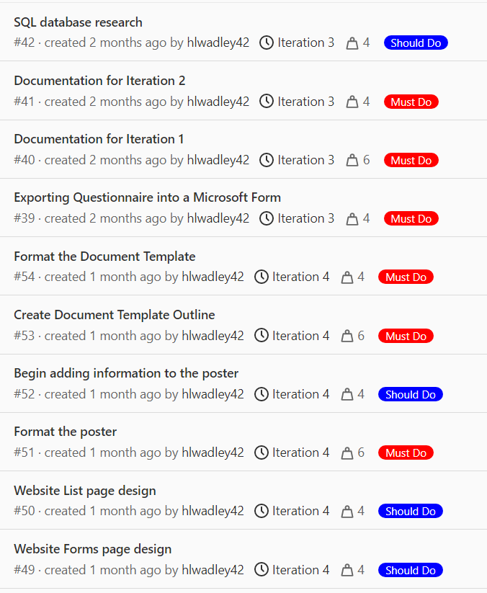
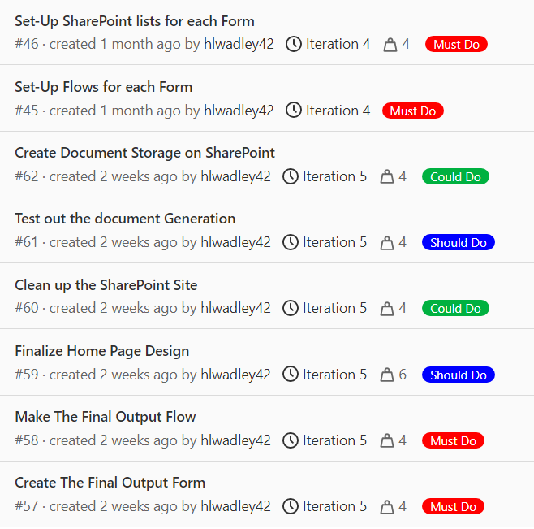
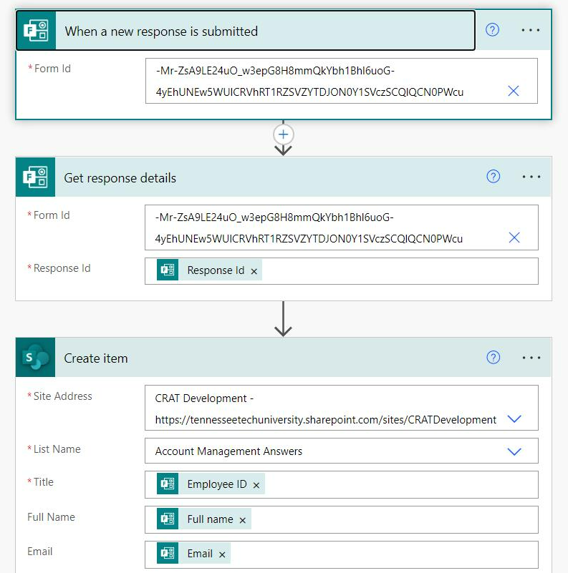
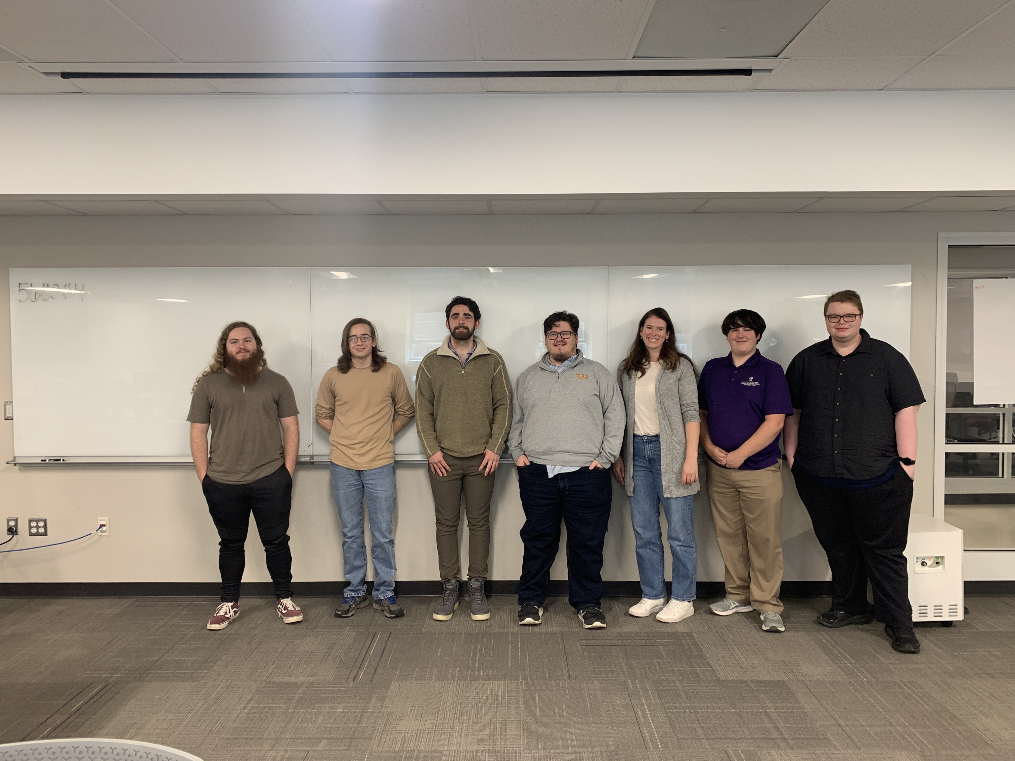

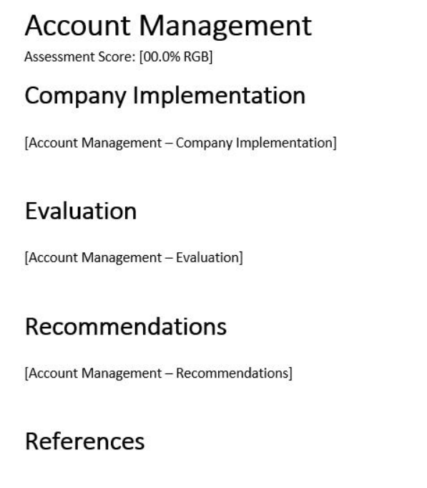
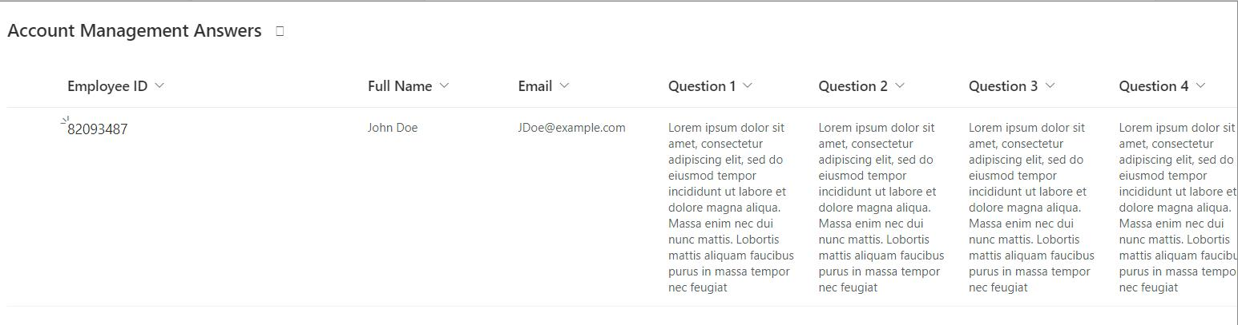
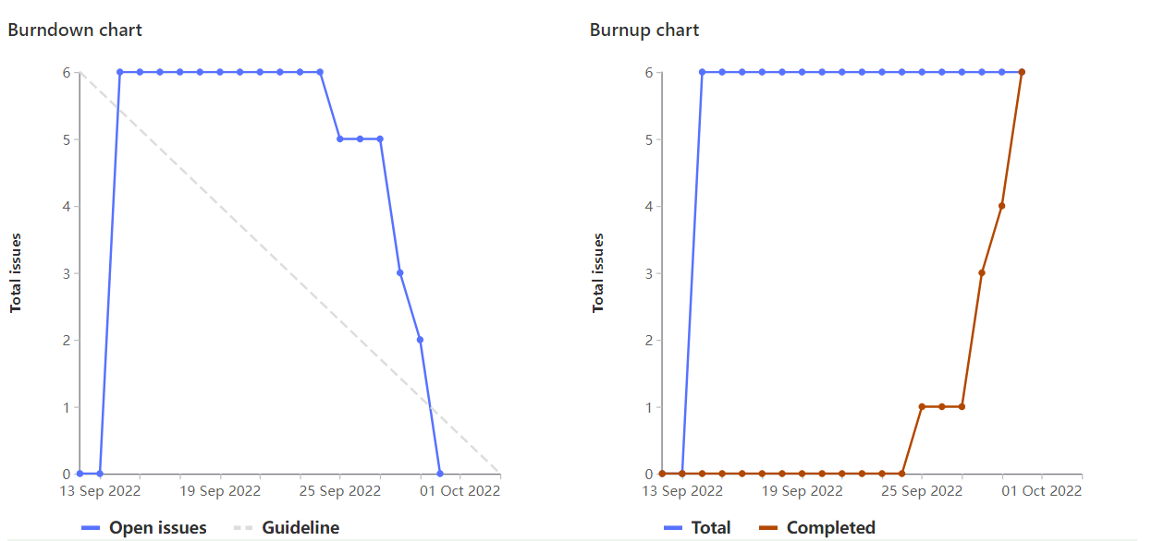
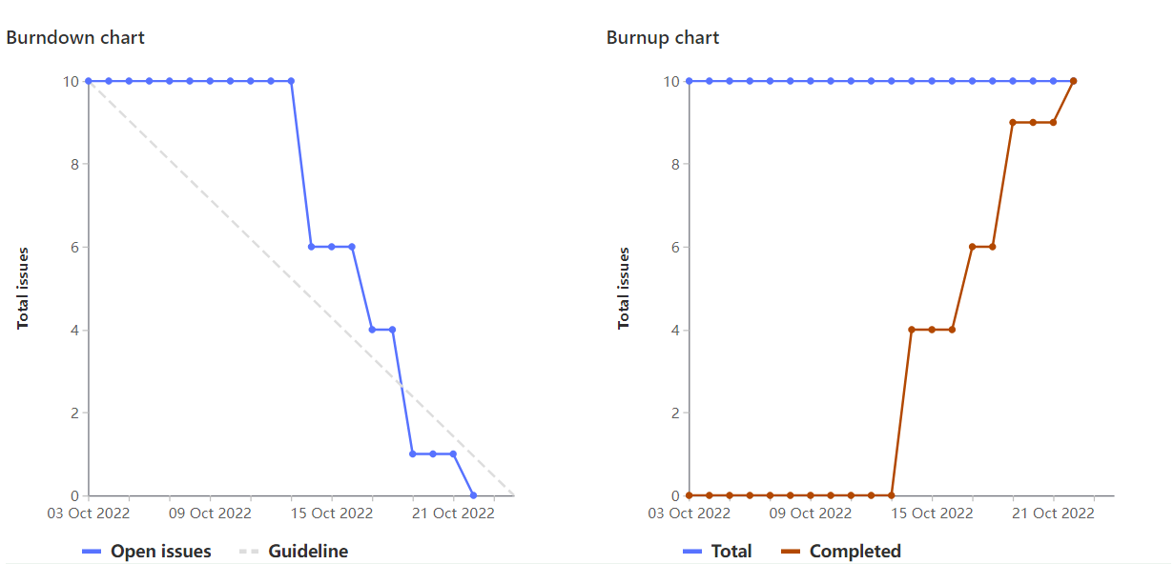




Cyber Risk Assessment Tool
Cyber Risk Assessment Team
Client: Eric Brown, Faculty Advisor: Sharanya Aavunoori
CEROC (Cybersecurity Education Research & Outreach Center)
Department of Computer Science, Tennessee Technological University
Introduction
Project Progress Weights and Priorities
Microsoft SharePoint Automation
Our team acquired the developed and fully functional Cyber Risk Assessment Tool. The team was tasked with researching how to integrate the Cyber Risk Assessment Tool project with Microsoft SharePoint and Microsoft Office Suites tools.
This tool will fill a gap in automation for CEROC and the Risk evaluation process. A once mostly hand-written process has been moved over to an online platform with features we hope will make the process more efficient.
4
6
10
We used a sliding scale of weights ranging from 4 to 6 to 10 depending on the difficulty and importance of the task.
Agile Sprint Board Overview
Microsoft Form
Team
Harris Wadley: Scrum Master, Team Lead
Lindsay Malugin: Project Communicator, Developer
Quincy Card: Developer, Research
Davis O'Donnell: Developer, Research
Andrew Branstetter: Developer
Tyler Earps: UI/UX Design Lead
Nicholas Rajic: UI/UX Design Team
Microsoft Flow
User stories our team has accomplished.
Weight rankings determined based on the MoSCoW method.
Burn-up/Burn-down Charts
Microsoft List
CEROC and Cyber Risk Assessment Background
Document Template
CEROC is the Cybersecurity Education Research and Outreach center established by the Department of Computer Science and College of Engineering.
Cyber Risk Assessment Tool was created by CEROC and the Industrial Assessment Center to provide cybersecurity risk assessments for small to mid-size manufacturing companies throughout Tennessee.
An on-site risk evaluation is performed through surveys and interviews. With the collected company data, it is evaluated against a scoring rubric referenced by the NIST Cybersecurity Framework, NIST SP documents, and the Center for Security and Emerging Technology. A final report is generated and provided to the surveyed company.
Conclusions
Overall, this project provided the team with a rewarding experience and introduction to the Microsoft Office Suite—as well as working in an Agile environment. During future iterations of this project, the use of Power Automate Premium features and SQL integration could continue to streamline the Risk Evaluation Process
.
Linear progress made over the last two iterations.
Microsoft SharePoint Development
Researched the development of Microsoft SharePoint.
Understanding Microsoft tools—Forms, Power BI, etc.
Migrated report survey questions to SharePoint.
Exported the NIST/NICE references to a SharePoint List.
Exported survey questionnaire into Microsoft Forms.
Created Microsoft Forms to SharePoint.
Established Flows for each Form.
SharePoint List for each Form.
Acknowledgments
Eric Brown – Client
Sharanya Aavunoori – Faculty Advisor
CEROC
The Department of Energy
References
Eric Brown
Previous Cyber Risk Assessment Team
General Copy Audit Report

